Slide 1


Swings and Strikes: Analyzing Hitting and Pitching Performance in Baseball

Slide 2
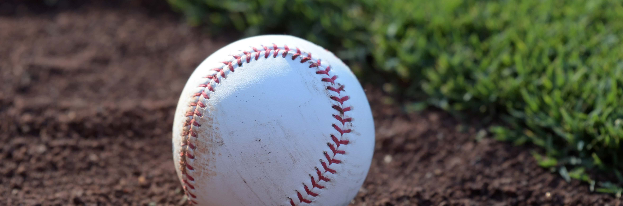
A Brief Insight Into The Study
The modern game of baseball is known for being highly statistical. Fanatics and Players alike are obsessed with the numbers behind the game. Despite the obsession however, there are many questions that remain under debate. In this brief statistical analysis, we will present a few perspectives as to which metrics are the most crucial, and which aspects of the game should receive the garner attention.

Slide 3

Our Questions
Which variables have the highest levels of statistical significance and why?
How should hitters balance power and average?
Which is better?
Good Pitching + Bad Hitting
Bad Pitching + Good Hitting

Slide 4

What Statistics Win Games? Diving into the 2024 MLB Cumulative Statistics Performing Regressions on Key Stats in Relation to Team Win / Loss Records (R²) Identifying Significance through P Values (Level .05 sig)

Slide 5

Notable Statistics
Hitting (Excluding Runs per 9 (R/9)
AVG: Batting Average
SLG: Slugging Percentage
OPS: On base + Slugging
SO/9 B: Strikeouts per 9 Innings Hitters
Pitching (Excluding Earned Run Avg (ERA)
BAA: Batting AVG Against
SO/9 P: Strikeouts per 9 Innings Pitchers
BB/9: Walks Per 9 Innings
WHIP: Walks and Hits per Inning

Slide 6
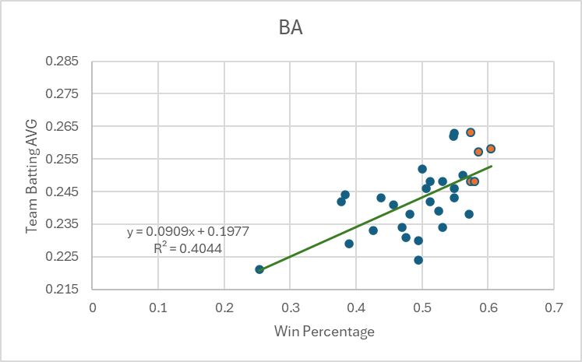
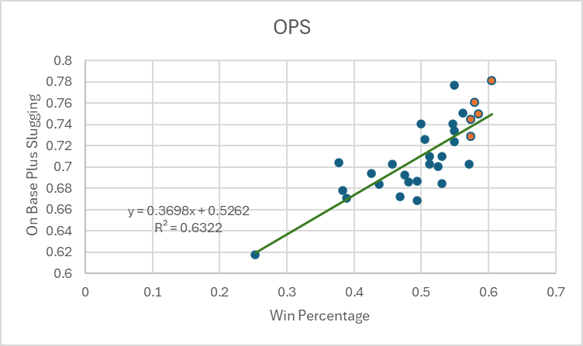
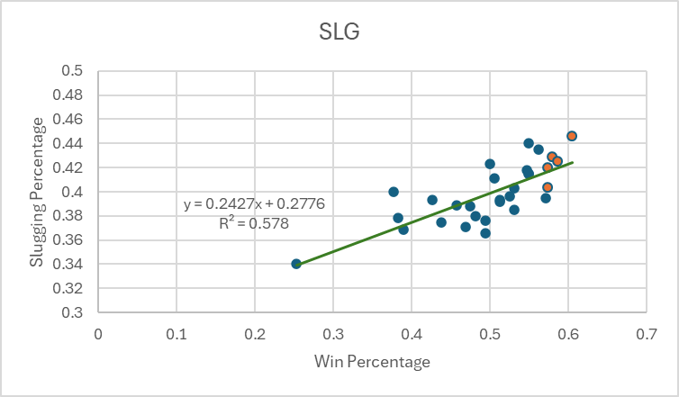
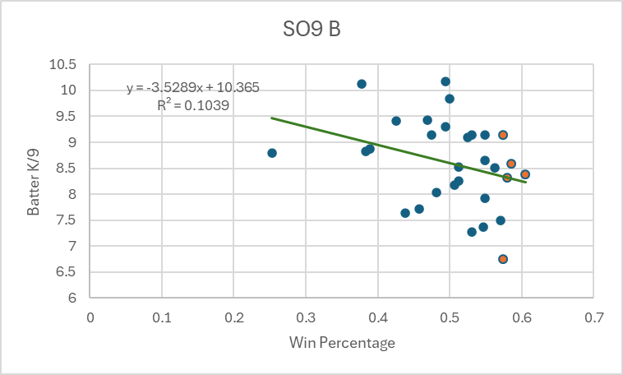
Hitting Regressions
Note: The 5 Orange dots on each graph represent the teams with the top 5 W/L records in the MLB

Slide 7
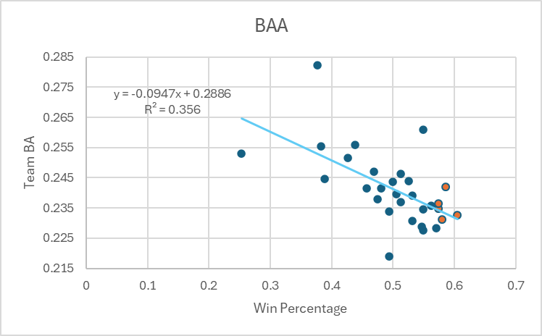
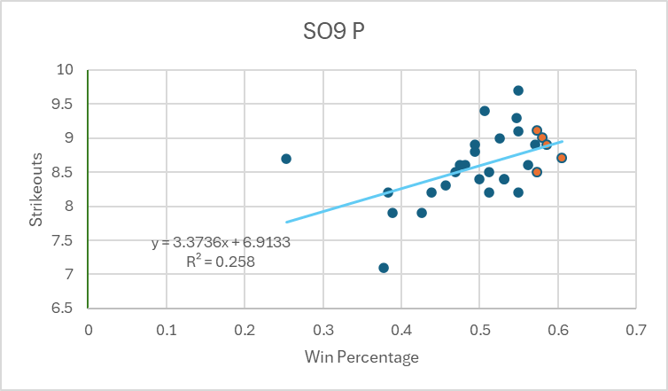
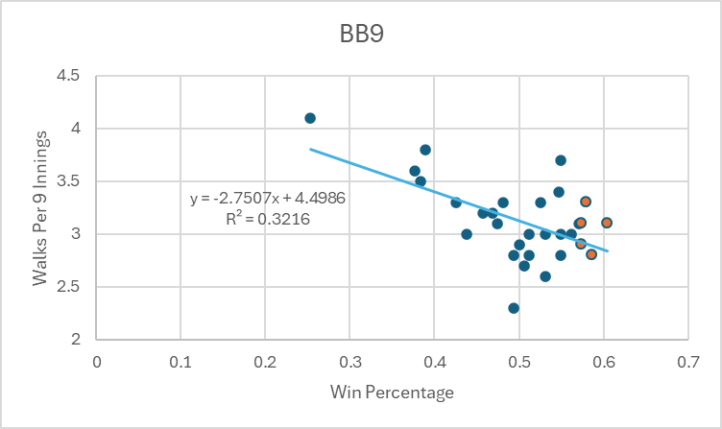
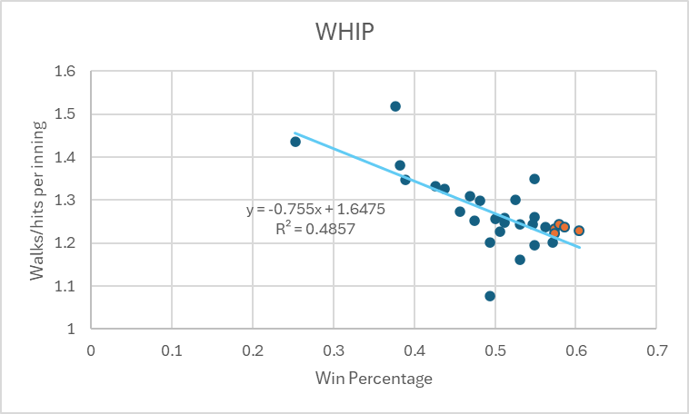
Pitching Regressions
Note: We Would have looked at HR/9, however upon review, teams had very low variety in HR allowed per game, therefore no statistical significance would have existed

Slide 8

Most Crucial Batting Statistic
OPS is clearly the most significant statistic for hitters. Having a p value that is essential 0 implies theoretical certainty that OPS has a strong and direct impact on a team’s win percentage. Not only this, but the R² value of .6322 means that over 60% of the variation in team win percentage can be explained by variation in OPS.

Slide 9
Most Crucial Batting Statistic (Continued)
Although OPS reigns far above all other statistics, we must note that this is largely due to the slugging aspect of this statistic. A few of the main statistics that make up OPS are OBP (On Base Percentage), and Slugging Percentage. When we look at the data above, the significance level of SLG far outweighs that BA. Through this analysis, we can get a clear idea of what separates the good teams from the championship teams
BA certainly is significant, and teams that hit more will tend to win more games; however, the numbers clearly show that power is crucial to being one of the greats

Slide 10

Most Crucial Pitching Statistic
WHIP is very clearly the most significant pitching statistic. It makes sense seeing as giving up walks and hits would likely cause more losses. We were more curious about the layers behind this statistic, which is why we looked comparatively at BAA, SO9, and BB9 to see which contributed most to the importance of WHIP. That being said, we found that the statistic with the highest level of significance between the three was BAA by a fair margin
So often there is a misconception that giving up walks is worse than giving up hits, however this data seems to disprove that theory from a statistical standpoint

Slide 11
Not all teams are built alike, and not all teams can budget to have both a strong offense as well as a great pitching staff. Now we need to find which side of the game can be sacrificed, and which one is a necessity Let's take a look at some simple AB Cluster tests

Slide 12
Looking at R/G and ERA, the top teams in each category are as follows
When averaged, the R/G leaders category yielded approximately 3% more wins. That being said, because the sample size is so small that the p value would be greater than 0.1, implying that this statistic is not significant. This however is just for category leaders. What about for teams that are skewed one way or another? Does it even matter?

Slide 13
We Identified 4 teams for each Category They are as follows
These were the four teams that we found to be the most statistically skewed in one direction or another for each category. The results showed that there is no significance concerning which matters more between batting and pitching. There are plenty of other ways to go about finding whether or not one is better than the other, but it is clear that the two sides will ultimately find a way to even out in the end.

Slide 14
So How Do We Answer?

Slide 15
Which variables have the highest levels of statistical significance and why?
Batting: The most significant variable we found was OPS; however, this was largely due to the slugging aspect of the statistic and did not have as much to do with a hitter's batting average as we thought it might have. We also found that the overall significance level of SLG was far higher than batting average which was surprising. While it is difficult for a hitter to obtain a high OPS without a high batting average, slugging percentage has a much larger impact on this statistic overall.
Pitching: For pitchers, the most significant statistic was WHIP. This was expected, however what we really found interesting was the lack of impact that “home runs allowed” made despite our findings about SLG significance for hitters. We found that most teams averaged the same number of home runs allowed per game implying little to no significance at all. It was also interesting that despite the lower statistical significance of BA as a hitting statistic, the BAA statistic held a much higher significance level than all variables excluding WHIP.

Slide 16
How should hitters balance power and average?
It is important to address this from 2 perspectives. From a hitter's perspective, statistically it was abundantly clear that power is king. The data would say that striking out doesn’t matter, and that to sell out trying to amplify your power statistics. On the other hand, however, the WHIP (Walks and Hits per inning) statistic would imply that patience is a virtue, and the lack of significance that the home runs allowed statistic displays would suggest that giving up big hits is not as impactful as the sheer number of them.
There is clearly a balance to be had. After analyzing the results, sitting on specific pitches in specific locations appears to be the best course of action. This allows for hitters to still hit for power without sacrificing patience as a virtue. Strikeouts were the most insignificant statistic that we found in our analysis on both sides, therefore if a hitter doesn’t receive a pitch that he is looking for in one turn at the plate, and that turn results in a strikeout, it is fine as he will ultimately be able to get more hits that are more powerful in the long run.

Slide 17
Which is better? Good Pitching + Bad Hitting Bad Pitching + Good Hitting
While it would be nice to have both, like we said before, for most franchises this is simply not possible due to budget constraints. Our findings as to which side of the game teams should focus on showed that it really depends on preference. The is no true significant difference between the win/loss records of teams that lean in either direction. Actually, the data showed that teams with high R/G also have low team ERA’s, and that teams with low R/G have higher team ERA’s. Teams with average R/G also reflected this pattern having average team ERA’s.
This statistic is disheartening for baseball fans as it highlights the MLB’s pay to win concerns. With no salary cap and extremely flexible spending limits, teams who spend more for both sides inevitably run the league, whereas teams that cannot spend as much simply can’t compete. This is largely due to the length of the MLB season, which makes upset wins far less impactful, and requires a consistent push to the top.

Slide 18
Questions?

